Slide 1
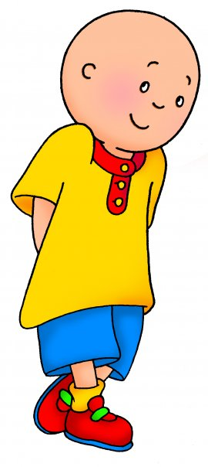
A Routine Day İn My Life
I ‘m caillou and this is what I do everyday

Slide 2
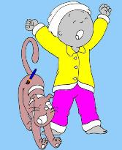
I get up at 7:30

Slide 3
I wash my hands and face at 7 :35

Slide 4
I get dressed at 7 :45

Slide 5
I brush my hair at 7:55

Slide 6
I have breakfast at 8:00

Slide 7
I leave home for school at 8:30

Slide 8
I play in the garden at breaks at 10:20

Slide 9
I have lunch at 12 :00

Slide 10
I catch a bus home at 15:30

Slide 11
I rest for a while

Slide 12
I have dinner at about 19:00

Slide 13
I do my homework at 19:30

Slide 14
I go to bed at 21:00

